Slide 1
Unit-V
Backtracking

Slide 2
Difficult Problems
Partition
  Partition n positive integers s₁, s₂, s₃, …, s_{n} into two groups A and B such that the sum of the numbers in each group is the same.
  [9, 4, 6, 3, 5, 1,8]
  A = [9, 4, 5] and B = [6, 3, 1, 8]

Slide 3
Subset Sum Problem
  Does any subset of n positive integers s₁, s₂, s₃, …, s_{n} have a sum exactly equal to c?
  [9, 4, 6, 3, 5, 1,8] and c = 18
  A = [9, 4, 5]

Slide 4
Traveling Salesperson Problem (TSP)
Let G be a weighted directed graph.
A tour in G is a cycle that includes every vertex of the graph.
TSP => Find a tour of shortest length.

Slide 5
n-Queens Problem
A queen that is placed on an n x n chessboard, may attack with any other queen placed in the same column, row, or diagonal.
8x8 Chessboard

Slide 6
Can n queens be placed on an n x n chessboard so that no queen attacks another queen?
4x4
Notes:
Problem may be solved in O(n) time by considering the cases: n is odd, n mod 6 = 2, else (n is even and n mod 6 != 2). However, solution eluded researchers for years. Although problem is no longer hard, it was hard for quite a while. See Explicit solutions to the N-queens problem for all N, Bo Bernhardsson, ACM SIGART Bulletin, 2(2), page 7. No placement is possible for n < 4. For n >= 4, the placement is always possible.

Slide 7
8x8

Slide 8
Difficult Problems
Many difficult problems require you to find either a subset or permutation that satisfies some constraints and (possibly also) optimizes some objective function.
These may be solved by organizing the solution space into a tree and systematically searching this tree for the answer.

Slide 9
Solution Space
Solution Space is a set that includes at least one solution to the problem.
Subset problem.
  n = 2, {00, 01, 10, 11}
  n = 3, {000, 001, 010, 100, 011, 101, 110, 111}
Solution space for subset problem has 2^{n} members.
Non systematic search of the space for the answer takes O(2^{n}) time.

Slide 10
Solution Space
Permutation problem.
  n = 2, {12, 21}
  n = 3, {123, 132, 213, 231, 312, 321}
Solution space for a permutation problem has n! members.
Non systematic search of the space for the answer takes O(n!) time.

Slide 11
Backtracking and Branch and Bound
Backtracking and branch and bound perform a systematic search and take much less time than the time taken by a non systematic search.

Slide 12
Tree Organization Of Solution Space
Set up a tree structure such that the paths from root to leaves represent members of the solution space.
For a size n subset problem, this tree structure has 2^{n} leaves.
For a size n permutation problem, this tree structure has n! leaves.
The tree structure is too big to store in memory; it also takes much time to create the tree structure.
Portions of the tree structure are created by the backtracking and branch and bound algorithms as needed.
Notes:
Tree organizations in which nonleaf nodes represent members of the solution space are also possible.

Slide 13
Subset Problem tree structure
Use a full binary tree that has 2^{n} leaves.
At level i the members of the solution space are partitioned by their x_{i} values.
Members with x_{i} = 1 are in the left subtree.
Members with x_{i} = 0 are in the right subtree.

Slide 14
Subset Tree For n = 4
( fixed – sized tuple )
x₁=1
x₁= 0
x₂=1
x₂= 0
x₂=1
x₂= 0
x₃=1
x₃= 0
x₄=1
x₄=0
0111
0001
1110
1011

Slide 15
Permutation Problem tree structure
Use a tree that has n! leaves.
At level i the members of the solution space are partitioned by their x_{i} values.
Members (if any) with x_{i} = 1 are in the first subtree.
Members (if any) with x_{i} = 2 are in the next subtree.
And so on.

Slide 16
Permutation Tree For n = 3
x₁=1
x₁= 3
x₁=2
x₂= 2
x₂= 3
x₂= 1
x₂= 3
x₂= 1
x₂= 2
x₃=3
x₃=2
x₃=3
x₃=1
x₃=2
x₃=1
123
132
213
231
312
321

Slide 17
Backtracking
Searches the solution space tree in a depth-first manner.
Will be done recursively.
The solution space tree exists only in your mind, not in the computer.

Slide 18
Backtracking Depth-First Search
x₁=1
x₁= 0
x₂=1
x₂= 0
x₂=1
x₂= 0

Slide 19
Backtracking Depth-First Search
x₁=1
x₁= 0
x₂=1
x₂= 0
x₂=1
x₂= 0

Slide 20
Backtracking Depth-First Search
x₁=1
x₁= 0
x₂=1
x₂= 0
x₂=1
x₂= 0

Slide 21
Backtracking Depth-First Search
x₁=1
x₁= 0
x₂=1
x₂= 0
x₂=1
x₂= 0

Slide 22
Backtracking Depth-First Search
x₁=1
x₁= 0
x₂=1
x₂= 0
x₂=1
x₂= 0

Slide 23
n – queens problem:-
The problem is to place n queens on an n×n chessboard so that no two “attack” that is no two queens on the same row, column, or diagonal.

Slide 24
Defining the problem:-
Assume rows and columns of chessboard are numbered 1 through n.
Queens also be numbered 1 through n.
Since each queen must be on a different row ,hence assume queen i is to be placed on row i.
Therefore all solutions to the n-queens problem can be represented as n-tuples ( x₁,x₂,…..x_{n}), where x_{i} is the column on which queen i is placed.

Slide 25
Tree structure for the case n=4.

Slide 26
1
X₁=1
X₁=4
X₁=2
X₁=3
2
34
50
18
x₂=
1
2
4
1
2
3
2
3
4
1
3
4
3
8
13
19
24
29
35
40
45
51
56
61
x₃=
3
4
2
4
2
3
3
4
1
4
1
3
2
4
1
4
1
2
2
3
1
3
1
2
4
6
9
11
14
16
20
22
25
27
30
32
36
38
41
43
46
48
52
54
57
59
62
64
x₄=
4
3
4
2
3
2
4
3
4
1
3
1
4
2
4
1
2
1
3
2
3
1
2
1
5
7
10
12
15
17
21
23
26
28
31
33
37
39
42
44
47
9
53
55
58
60
63
65
Tree organization of the 4-queens solution space. Nodes are numbered as in depth first search.

Slide 27
1
x₁=1
x₁=2
2
18
x₂=2
x₂=3
x₂=4
x₂=4
3
8
13
29
19
24
B
B
B
x₃=1
9
11
14
16
30
B
B
B
x₄=3
15
31
B
Portion of the tree that is generated during backtracking( n=4 ).

Slide 28
n - queens problem algorithm
Every element on the same diagonal that runs from the upper left to the lower right has the same row – column value.
Similarly, every element on the on the same diagonal that goes from the upper right to the lower left has the same row + column value.

Slide 29
If two queens are placed at positions ( i, j ) and ( k, l ) , then they are on the same diagonal only if
i – j = k – l or i + j = k + l
First equation implies
j – l = i – k
Second equation implies
j – l = k – i
Therefore, two queens lie on the same diagonal if and only if j – l = i – k

Slide 30
Algorithm place( k, l )
// It returns true if a queen can be placed in column l
// It tests both whether i is distinct from all previous values
// x [ 1 ], ….x [ k-1 ] and there is other queen on the same
//diagonal.
// Abs(r) returns the absolute value of r.
{
for j = 1 to k-1 do // for all previous queens
{ // Two in the same column or in the same diagonal
if ( ( x [ j ] = l ) or ( Abs( x[ j ] - l ) = Abs( j - k ) ) ) then
return false;
}
return true ;
}

Slide 31
Algorithm NQueen(k,n)
//Using backtracking, this procedure prints all
//possible placements of n queens on an n×n
//chessboard so that they are nonattacking.
{
for l =1 to n do // check place of column for queen k
{
if place( k, l ) then
{
x[ k ] = l;
if( k = n )then write( x[1:n] );
else NQueens( k+1, n);
}
}
}

Slide 32
Sum of subsets
Given n distinct positive numbers w_{i}, and m, find all subsets that sum to m.
We can formulate this problem using either
  Fixed- or variable – sized tuples.

Slide 33
Variable- sized tuple
Ex:- n=4, ( w1, w2, w3, w4 )= ( 11,13, 24, 7 ), m=31.
  Solutions are ( 11, 13, 7 ) and ( 24, 7 )
Rather than representing the solution by w_{i} ’s, we can represent by giving the indices of these w_{i}
Now the solutions are ( 1, 2, 4 ) and ( 3, 4 ).
Different solutions may have different-sized tuples.
We use the following condition to avoid generating multiple instances of the same subset ( e.g., ( 1,2,4) and (1,4,2) )
  x_{i} < x_{i+1}

Slide 34
Subset Tree for n=4 (variable- sized tuple )
1
x₁=1
x₁=4
x₁=2
x₁=3
3
4
5
2
x₂=4
x₂=3
x₂=4
x₂=4
x₁=2
x₂=3
8
9
10
11
6
7
x₃=3
x₃=4
x₃=4
x₃=4
12
13
14
9
x₄=3
16
Nodes are numbered as in Breadth first search.

Slide 35
Fixed- sized tuple
In this method, each solution subset is represented by an n-tuple (x₁,x₂,…..x _{n}).
x _{i}=0 if w_{i} is not chosen and x_{i}=1 if w_{i} is chosen
Subset Tree for n=4 (Fixed- sized tuple )
We have already discussed.
Copy that tree.

Slide 36
Subset Tree For n = 4
( fixed – sized tuple )
x₁=1
x₁= 0
x₂=1
x₂= 0
x₂=1
x₂= 0
x₃=1
x₃= 0
x₄=1
x₄=0
0111
0001
1110
1011

Slide 37
Algorithm of sum of subsets
Backtracking solution using fixed- sized tuple.
A simple choice for bounding function is B_{k}(x₁,x₂,…..,x_{k})= true iff
∑ w_{i}x_{i} + ∑ w_{i} ≥ m
Clearly x₁,x₂,……x_{k} cannot lead to an answer node if this condition is not satisfied.
k
n
i=1
i=k+1

Slide 38
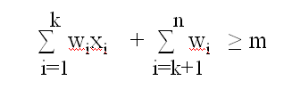
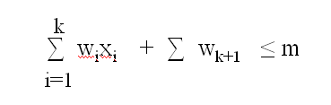
The bounding function strength further can be increased if we assume the w_{i}’s in increasing order.
In this case x₁,x₂,……x_{k} cannot lead to an answer node if
∑ w_{i}x_{i} + ∑ w_{k+1} > m
Therefore, the bounding functions we use are
  B_{k}(x₁,x₂,…..,x_{k})= true iff
k
i=1
and

Slide 39
The initial call is SumOfSub( 0, 1, ∑ w_{i} )
Algorithm SumOfSub( s, k, r )
// Find all subsets of w[ 1:n ] that sum to m
// It is assumed that w[1] ≤ m and ∑ w_{i} ≥ m
// The values of x[j] 1<=j<k, have already been determined.
// s= ∑ w[j]*x[j] and r= ∑ w[j] . W[j]’s in increasing order.
{
x[ k ]=1; // left child
if( s + w[k] = m ) then write( x[ 1: k ] ) ; // Subset found
else if ( s + w [ k ] + w[ k+1 ] ≤ m )
then SumOfSub( s+ w[k], k+1, r- w[k] )
n
i=1
n
i=1
K-1
n
j=1
j=k

Slide 40
// Generate right child and evaluate B_{k}
if ( ( s + r – w[ k ] ≥ m ) and ( s + w[ k+1 ] ≤ m ) ) then
{
x[ k ] = 0;
} SumOfSub( s, k+1, r- w[k] ) ;
}

Slide 41
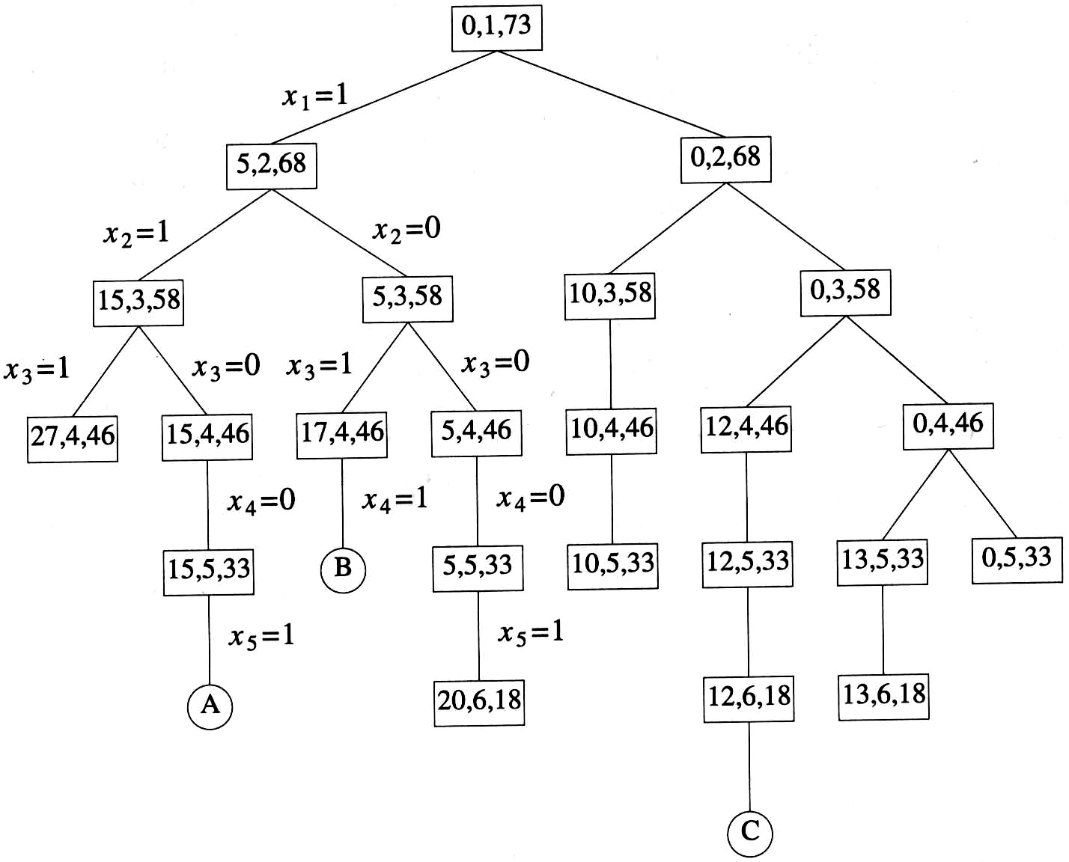
Ex:- n=6, m=30, w [ 1:6 ]= { 5,10,12,13,15,18 }
Portion of state space tree generated by SumOfSub. circular nodes indicate subsets with sums equal to m.
Example 7.6 (Figure 7.10)
  n=6, w[1:6]={5,10,12,13,15,18}, m=30

Slide 42
General method of Backtracking
Let T ( x[1], x[2],…..x[ k-1 ] be the partial solution
Algorithm Backtrack( k )
{
for( each x[k] € T ( x[1], x[2],…..x[ k-1 ] ) do
{
if( B_{k} (x[1], x[2],…..x[ k-1 ], x[k] is true ) then
{
if ( x[1], x[2],…..x[ k-1 ], x[k] ) is an answer )
then write( x [ 1; k ] );
if ( k < n ) then Backtrack ( k+1 );
}
}
}

Slide 43
Graph Coloring Problem
Assign colors to the vertices of a graph so that no adjacent vertices share the same color.
  Vertices i, j are adjacent if there is an edge from vertex i to vertex j.

Slide 44
Example
No.of Colors used: 2
Number of Possible ways : 2

Slide 45
No.of Colors used: 3
.
.
.
Some possible ways

Slide 46
M-colorability optimization problem asks for the smallest integer for which the graph can be colored.
This number is called chromatic number.

Slide 47
m-colorings problem:-
  Find all ways to color a graph with at most m colors.
  Problem formulation:-
  Represent the graph with adjacency matrix G[1:n,1:n].
  The colors are represented by integer numbers 1,2,….m.
  Solution is represented by n- tuple (x₁,….x_{n}), where x_{i} is the color of node i.

Slide 48
Solution space tree for mColorigng when n=3 and m=3
x₁=1
2
3
3
1
3
1
3
x₂ =1
2
2
2
X3 =1
2
3

Slide 49
A 4-node graph and all possible 3-colorings
1
2
4
3
x₁=
1
2
3
X₂=
2
3
1
3
1
2
X₃=
1
3
1
2
2
3
1
2
2
3
1
3
X₄=
2
3
2
2
3
3
1
3
1
3
1
3
1
1
2
2
1
2

Slide 50
Algorithm :- finding all m- colorings of a graph.
Function mColoring is begun by first assiging the graph to its adjacency matrix, setting the array x[ ] to zero, and then invoking the statement mColoring( 1 );
Algorithm mColoring( k )
// k is the index of the next vertex to color.
{
repeat
{ // Generate all legal assignments for x[k]
NextValue( k ); // Assign to x[k] a legal color
if ( x[k]=0 ) then return; // No new color possible
if ( k=n ) then // At most m colors have been used to color the n vertices
write( x[1:n] );
else mColoring( k+1);
} until ( false );
}

Slide 51
Algorithm NextValue( k )
// x[1],…..x[ k-1 ] have been assigned integer values in the range [ 1 ,m ].
// A value for x[ k ] is determined in the range [ 0,m ]
{
repeat
{
x[k] = ( x[k] +1) mod ( m+1 ); // Next highest color.
if ( x[k]=0 ) then return; // All colors have been used.
for j = 1 to n do
{
if (( G[ k, j ] ≠ 0 ) and ( x[k] = x[j] )) then
break;
}
if( j = n+1 ) then return; // Color found
} until ( false );
}

Slide 52
Hamiltonian cycles:-
A Hamiltonian cycle is a round-trip path along n edges of connected undirected graph G that visits every vertex once and returns to its starting position.
The above graph contains the Hamiltonian cycle
1,2,8,7,6,5,4,3,1
1
2
3
4
8
7
6
5

Slide 53
The above graph does not contain Hamiltonian cycles.
1
2
3
5
4

Slide 54
  Find all possible Hamiltonian cycles
  Problem formulation:-
  Represent the grapth with adjacency matrix G[1:n,1:n].
  Solution is represented by n- tuple (x₁,….x_{n}), where x_{i} represents the i^{th} visited vertex of the cycle.
  Start by setting x[ 2: n ] to zero and x[ 1 ]=1, and then executing Hamiltonian( 2 );

Slide 55
Algorithm Hamiltonian( k )
{
repeat
{ // Generate values for x[k]
NextValue( k ); // Assign a legal next value to x[ k ]
if ( x[k]=0 ) then return; // No new value possible
if ( k=n ) then write( x[1:n] );
else Hamiltonian( k+1);
} until ( false );
}

Slide 56
Algorithm NextValue( k )
{
repeat
{
x[k] = ( x[k] +1) mod ( n+1 ); // Next vertex.
if ( x[k]=0 ) then return;
if( G[ x[ k-1], x[ k ] ] ≠ 0 )
{
for j:= 1 to k-1 do if ( x[ j ] = x [k ] ) then break;
if( j = k ) then // if true, then the vertex is distinct
if( ( k < n ) or ( ( k=n ) and G [ x[n], x[1]] ≠ 0 )
then return;
}
} until ( false );
}

Slide 57
State Space :-
All paths from the root to other nodes define the state space of the problem.
Solution Space :-
All paths from the root to solution states define the solution space of the problem.

Slide 58
Ex :-
1
X₁=1
X₁=4
X₁=2
X₁=3
2
34
50
18
x₂=
1
2
4
1
2
3
2
3
4
1
3
4
3
8
13
19
24
29
35
40
45
51
56
61
x₃=
3
4
2
4
2
3
3
4
1
4
1
3
2
4
1
4
1
2
2
3
1
3
1
2
4
6
9
11
14
16
20
22
25
27
30
32
36
38
41
43
46
48
52
54
57
59
62
64
x₄=
4
3
4
2
3
2
4
3
4
1
3
1
4
2
4
1
2
1
3
2
3
1
2
1
5
7
10
12
15
17
21
23
26
28
31
33
37
39
42
44
47
9
53
55
58
60
63
65
Tree organization of the 4-queens solution space. Nodes are numbered as in depth first search.

Slide 59
Problem state :-
Each node in the tree is a problem state.
Ex:-
and so on
1
2
18

Slide 60
Solution States :-
These are those problem states S for which the path from the root to S define a tuple in the solution space.
Ex:-
and so on
5
7
10
12
15
17
21

Slide 61
General Backtracking Algorithms :-
Assume all answer nodes are to be found.
Let (x1,x2,…..,xi) be a path from the root to a node xi in a state space tree .
Let T(x1,x2,…..xi) be the set of all possible paths for x_{i+1} such that (x1,x2,…….., x_{i+1}) is also a path to a problem state.
Assume bounding functionBi+1 ( implicit conditions) such that if Bi+1(x1,x2,……,xi+1) is false for a path (x1,x2,…xi+1) , then the path cannot be expanded to reach an answer node.

Slide 62
General Recursive backtracking Algorithm:-
Algorithm Backtrack( k )
// The first k-1 values have been assigned.
// x[ ] and n are global.
{
for ( each x[k] € T(x[1],……x[k-1] )
{
if( Bk( x[1],x[2],…..x[k] ≠ 0) then
{
if(x[1],x[2],…..x[k] is a path to answer node )
then write( x[1:k] );
if ( k < n) then Backtrack( k+1 );
}
}
}

Slide 63
O(2^{n}) Subet Sum & Bounding Functions
{10, 5, 2, 1}, c = 14
x₁=1
x₁= 0
x₂=1
x₂= 0
x₂=1
x₂= 0
Each forward and backward move takes O(1) time.
Notes:
When you move forward on an x =1 branch, add to a variable that keeps track of the sum of the subset represented by the node. When you move back on an x = 1 branch, subtract. Moving in either direction along an x = 0 branch requires no add/subtract. When you reach a node with the desired sum, terminate. When you reach a node whose sum exceeds the desired sum, backtrack; do not move into this nodes subtrees. When you make a right child move see if the desired sum is attainable by adding in all remaining integers; for this keep another variable that gives you the sum of the remaining integers.

Slide 64
Bounding Functions
When a node that represents a subset whose sum equals the desired sum c, terminate.
When a node that represents a subset whose sum exceeds the desired sum c, backtrack. I.e., do not enter its subtrees, go back to parent node.
Keep a variable r that gives you the sum of the numbers not yet considered. When you move to a right child, check if current subset sum + r >= c. If not, backtrack.

Slide 65
Backtracking
Space required is O(tree height).
With effective bounding functions, large instances can often be solved.
For some problems (e.g., 0/1 knapsack), the answer (or a very good solution) may be found quickly but a lot of additional time is needed to complete the search of the tree.
Run backtracking for as much time as is feasible and use best solution found up to that time.

Slide 66
Branch And Bound
Search the tree using a breadth-first search (FIFO branch and bound).
Search the tree as in a bfs, but replace the FIFO queue with a stack (LIFO branch and bound).
Replace the FIFO queue with a priority queue (least-cost (or max priority) branch and bound). The priority of a node p in the queue is based on an estimate of the likelihood that the answer node is in the subtree whose root is p.

Slide 67
Branch And Bound
Space required is O(number of leaves).
For some problems, solutions are at different levels of the tree (e.g., 16 puzzle).
4
14
1
1
2
3
4
13
2
3
12
5
6
7
8
6
11
5
10
9
10
11
12
9
8
7
15
13
14
15

Slide 68
Branch And Bound
  FIFO branch and bound finds solution closest to root.
  Backtracking may never find a solution because tree depth is infinite (unless repeating configurations are eliminated).
Least-cost branch and bound directs the search to parts of the space most likely to contain the answer. So it could perform better than backtracking.

